Slide 1




www.causeway.education
@Causeway_Edu
Before we get started…..
Please check that you have a copy of: Skills for STEM Student Booklet.
Skills for STEM subjects
Year 11

Slide 2


Session objectives
By the end of the session you will be able to:
1
Use diagrams to explain ideas & convey information quickly and with impact
2
Use precise & accurate scientific terminology to ensure explanation of ideas is understandable
3
Apply scientific methodology by using key headings in a scientific poster
4
Analyse and select key concepts required when summarising information to include in a scientific poster.
www.causeway.education

Slide 3
Session overview
1
Starter – which of the scientific posters do you prefer?
2
What are scientific posters and how are they used in the world of scientific research?
3
What does a good scientific poster look like?
4
Researching your own scientific research poster
5
Note-taking techniques
6
Creating your own scientific research poster
www.causeway.education

Slide 4


About us
Ed Hill
Programme Officer
Katie Buckingham
Head of Programmes
www.causeway.education
Notes:
We are now just about ready to get started but before we do let us introduce ourselves.

Slide 5

1. Starter – which of the scientific posters do you prefer?

Slide 6
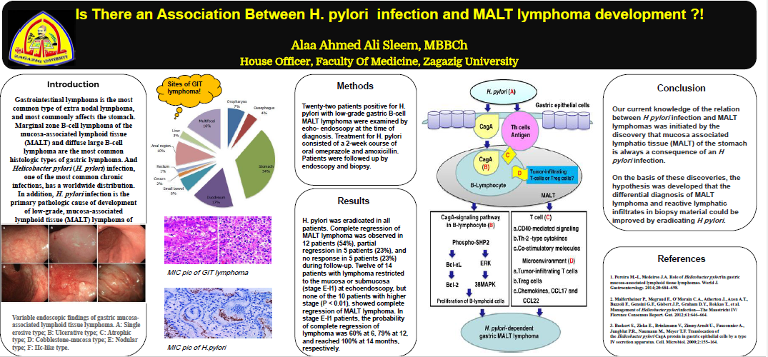
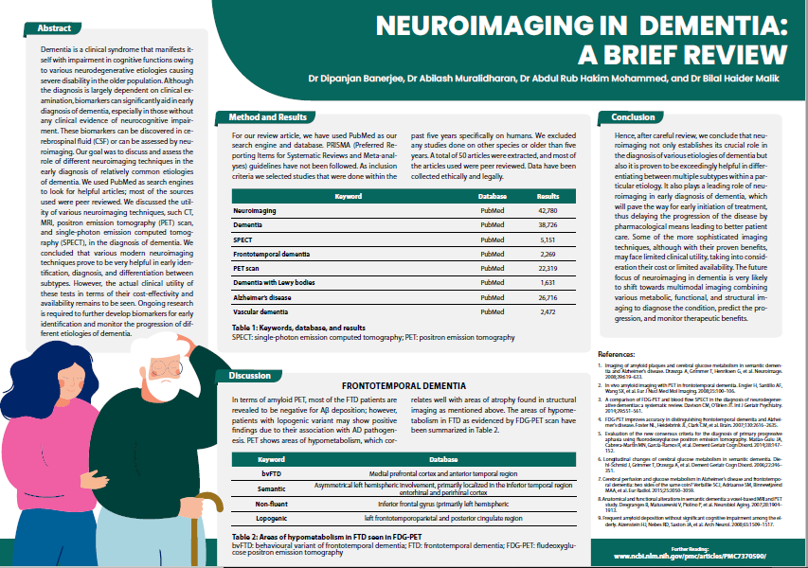
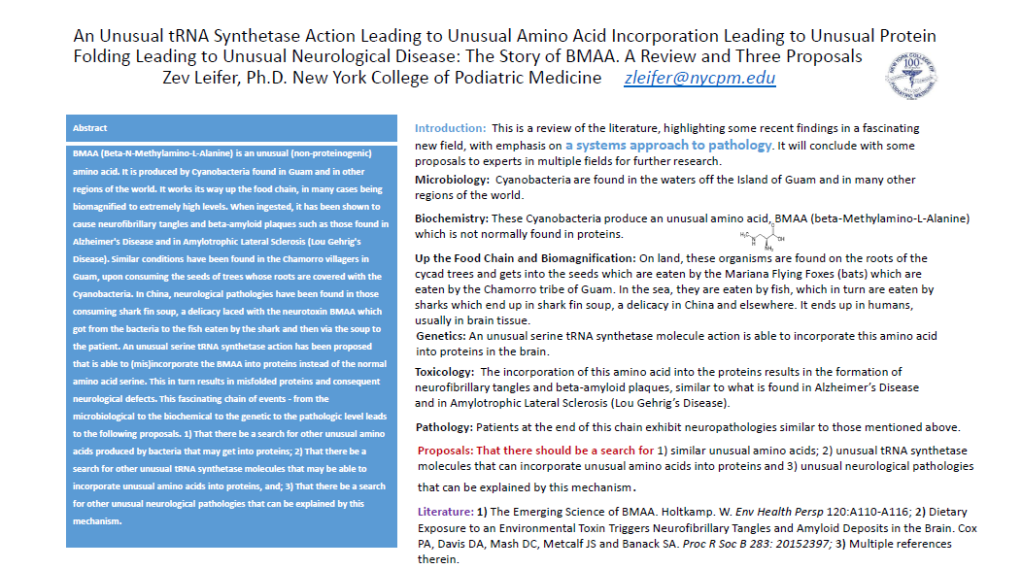
Which of the scientific posters do you prefer?
2.
1.
3.
Notes:
Starter activity – without any explanation of what scientific research posters are, what their purpose is, ask students to look at the 3 posters on the slide and in their booklet.
Ask them to think about which one catches their eye the most/which one do they like the most and why.
Feedback: we would say 1. is eye catching – good clear layout with sections, contrasting colours (text and background), an image, and a table of data. However, quite a lot of writing at a glance.
2. Is very eye catching because they have used coloured images and diagrams, not just text. Text is short and clearly sectioned
3. Not eye catching, far too much text, no images or diagrams, no clear sections or headings to break up text.
We’re now going to find out more about what scientific research posters are, what their purpose is and what makes a good one. But keep in mind your first impressions of these posters – without looking at the content in detail we have decided that the design and layout is important for attracting attention to the poster.

Slide 7
2. What are scientific posters and how are they used in the world of scientific research?

Slide 8
Scientific Posters – what is their purpose?
A way of showcasing your project/research at conferences and meetings. It is one of the main ways you will present your work at conferences.
Allows you to summarise your project into a concise and aesthetically pleasing format.
Unlike oral presentations, your audience may not be static - posters are viewed fleetingly at conferences
The aim is to really entice the viewer in to engage in more discussion about your piece of research

Slide 9
What are the features of a good scientific poster?
Limited text
Headline information only
Information presented in diagrams rather than words
Clear diagrams
No irrelevant images
Careful selection of information
Clear narrative of research
Notes:
What are the features of a good scientific poster?
Ask students to come up with a list of ideas/criteria to begin with. Then share the list on the slide.
Limited text
Clear diagrams
Headline info only
Info presented in diagrams rather than words
No irrelevant images
Careful selection of information
Clear narrative of research

Slide 10
3. What does a good scientific poster look like?
Notes:
.

Slide 11
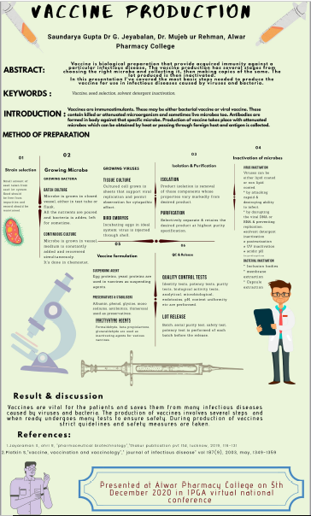
What does a good scientific poster look like?
Headline/carefully selected information only.
Clear narrative of research
Some images, but not scientific diagrams.
Information is mostly presented in words rather than diagrams.
Notes:
Example 1: https://cdn.technologynetworks.com/ep/pdfs/determination-of-grape-juice-sugars-content-by-hplc.pdf
Example 2: https://cdn.technologynetworks.com/ep/pdfs/immunity-buster-herbal-plant-during-covid-19-pandemic.pdf
Example 3: https://cdn.technologynetworks.com/ep/pdfs/health-vision-2030-an-era-of-evolution-and-revolution-in-india.pdf
Example 4: https://cdn.technologynetworks.com/ep/pdfs/steps-in-vaccine-production-.pdf

Slide 12
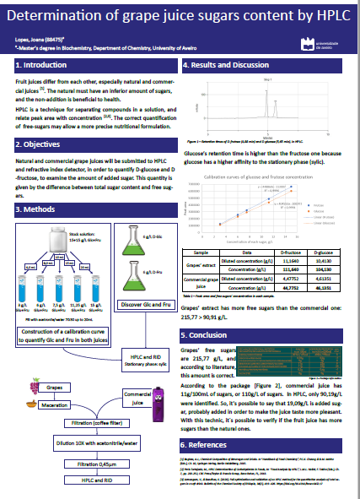
What does a good scientific poster look like?
Clear narrative of research – logical flow
Information presented in clear diagrams
Writing, although minimal, could be reduced to bullet points
Notes:
Example 1: https://cdn.technologynetworks.com/ep/pdfs/determination-of-grape-juice-sugars-content-by-hplc.pdf
Example 2: https://cdn.technologynetworks.com/ep/pdfs/immunity-buster-herbal-plant-during-covid-19-pandemic.pdf
Example 3: https://cdn.technologynetworks.com/ep/pdfs/health-vision-2030-an-era-of-evolution-and-revolution-in-india.pdf
Example 4: https://cdn.technologynetworks.com/ep/pdfs/steps-in-vaccine-production-.pdf

Slide 13
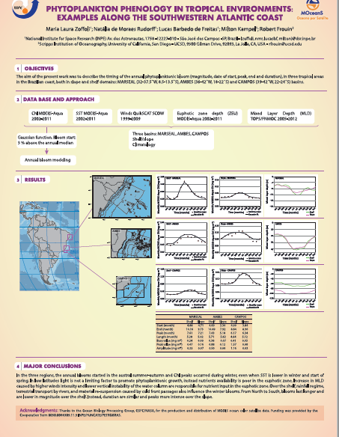
What does a good scientific poster look like?
Clear narrative of research – logical flow
Information presented in diagrams rather than words
Notes:
Example 1: https://cdn.technologynetworks.com/ep/pdfs/determination-of-grape-juice-sugars-content-by-hplc.pdf
Example 2: https://cdn.technologynetworks.com/ep/pdfs/immunity-buster-herbal-plant-during-covid-19-pandemic.pdf
Example 3: https://cdn.technologynetworks.com/ep/pdfs/health-vision-2030-an-era-of-evolution-and-revolution-in-india.pdf
Example 4: https://cdn.technologynetworks.com/ep/pdfs/steps-in-vaccine-production-.pdf

Slide 14
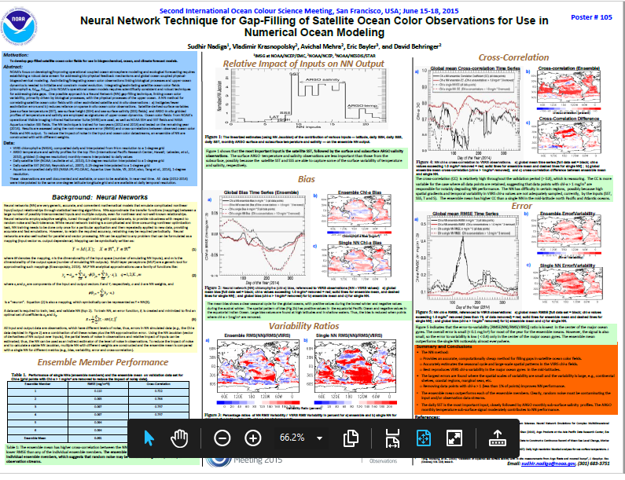
What does a good scientific poster look like?
Logical flow of research
Some information presented in diagrams rather than words
Too much information on the page.
Notes:
Example 1: https://cdn.technologynetworks.com/ep/pdfs/determination-of-grape-juice-sugars-content-by-hplc.pdf
Example 2: https://cdn.technologynetworks.com/ep/pdfs/immunity-buster-herbal-plant-during-covid-19-pandemic.pdf
Example 3: https://cdn.technologynetworks.com/ep/pdfs/health-vision-2030-an-era-of-evolution-and-revolution-in-india.pdf
Example 4: https://cdn.technologynetworks.com/ep/pdfs/steps-in-vaccine-production-.pdf

Slide 15
What does a good scientific poster look like?
Structure & Design
Do not overly embellish the poster with formatting and pictures - may distract from the content.
Information should be minimal - only key points rather than complete sentences.
Colour system should have effective contrasting backgrounds (e.g. blue and yellow, black and white) to ensure text is easy to read.
Flow of the poster should be logical - begin with aims and objectives and flow downwards in columns to methods, results, conclusions and finally references.
Notes:
Do not overly embellish the poster with formatting and pictures, as this may distract from the content.
Information should be minimal, as in a slide presentation, stating only key points rather than complete sentences.
Colour system should have effective contrasting backgrounds (e.g. blue and yellow, black and white) to ensure the text is easy to read.
Flow of the poster should be logical - begin with aims and objectives and flow downwards in columns to methods, results, conclusions and finally references.
https://www.sciencedirect.com/science/article/pii/S2049080116301303

Slide 16
What does a good scientific poster look like?
Task:
Now find 2 more examples of scientific posters by visiting: https://www.eposters.net/
Evaluate the posters using the criteria grid on page 4 in your booklet

Slide 17
PAUSE HERE

Slide 18
4.Researching your own scientific poster

Slide 19
Research
Task:
Find the list of scientific articles on page 5 of your booklet.
Choose the topic that looks most interesting to you and click on the link to read/download the article.
Over the next few activities you will be working towards creating your own scientific poster about this piece of research
Notes:
Articles:
https://www.sciencemag.org/news/2021/03/giraffe-genome-holds-keys-its-peculiar-body-and-clues-hypertension-treatments
https://www.sciencemag.org/news/2021/04/honey-bees-rally-their-queen-game-telephone
https://www.sciencemag.org/news/2021/04/food-supplements-alter-gut-bacteria-could-cure-malnutrition

Slide 20
PAUSE HERE

Slide 21
Glossary of Key Terms
A really important skill at A Level, when studying STEM subjects, is to be able to use key vocabulary correctly.
Task:
Re-read your chosen article.
Select any scientific vocabulary to create a glossary (alphabetical list of vocabulary) of the key terms from your selected topic/article.
You can do this on page 6 of your booklet

Slide 22
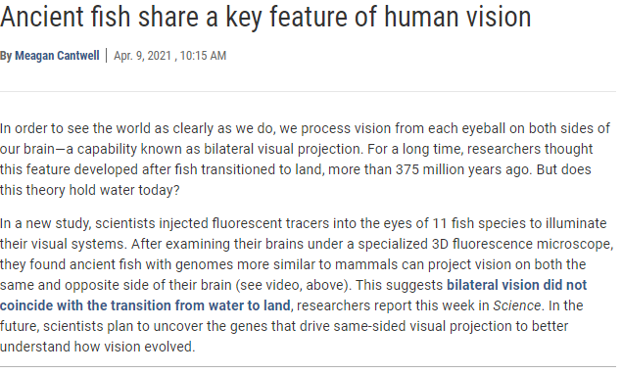
Glossary of Key Terms
Glossary
Fluorescent: bright and glowing as a result of fluorescence. A fluorescent surface, substance, or colour has a very bright appearance when light is directed onto it, as if it is actually shining itself.
Fluorescence microscope: an optical microscope that uses fluorescence to study the properties of organic or inorganic substances.
Gene: a segment of a DNA molecule that codes for a single polypeptide or protein.
Genome: the complete set of genes or genetic material present in a cell or organism.
Illuminate: to supply (something) with light : to shine light on (something)
Species: a group of living organisms consisting of similar individuals capable of exchanging genes or interbreeding.
Notes:
*Add highlighted words as animations*

Slide 23
PAUSE HERE

Slide 24
5. Note-taking techniques

Slide 25
Note-taking techniques
A-level topics are notoriously heavy on content – and note taking is a very useful but underrated skill.
Many different ways of taking notes in school or at university
Visual approach such as drawing mind maps
Structured approach using an outline method to take notes
Cornell note-taking method -a system for taking, organizing and reviewing notes (more efficient method but also makes it a lot easier to review notes, for example when preparing for an exam)

Slide 26
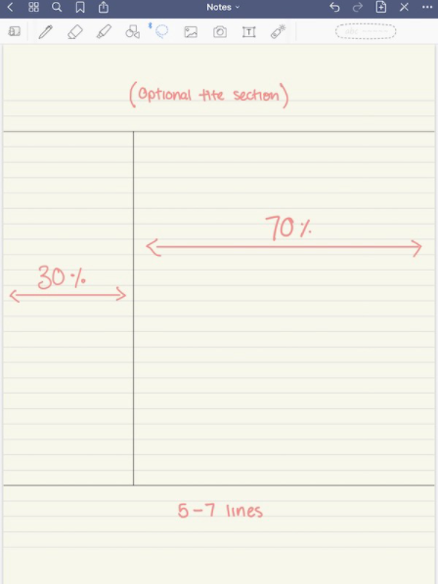
Cornell note-taking
It requires very little preparation which makes it ideal for note taking in class.
The page will be divided into 4 — or sometimes only 3 — different sections: Two columns, one area at the bottom of the page, and one smaller area at the top of the page:
Notes:
https://medium.goodnotes.com/study-with-ease-the-best-way-to-take-notes-2749a3e8297b

Slide 27
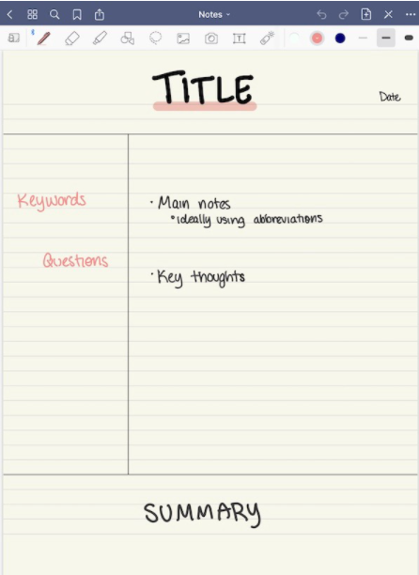
Cornell note-taking
It requires very little preparation which makes it ideal for note taking in class.
The page will be divided into 4 — or sometimes only 3 — different sections: Two columns, one area at the bottom of the page, and one smaller area at the top of the page:

Slide 28
Cornell note-taking
Task:
Let’s have a go at using the Cornell note-taking method now.
Go to page 8 in your booklet and divide your page as demonstrated on the previous slides.
Choose the YouTube video from the list on page 7 that matches your chosen research topic, watch the video and make notes as you watch.
PAUSE HERE
Notes:
Pre-prepared topics – listed in the student booklet:

Slide 29
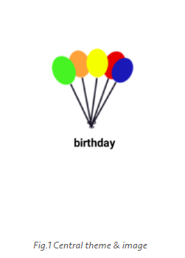
Mind-maps
Mind mapping helps you think, collect knowledge, remember and create ideas.
How to mind-map
Central theme: A central theme is placed in the centre of a blank page. This is the title, the subject, a problem or just a thought.

Slide 30
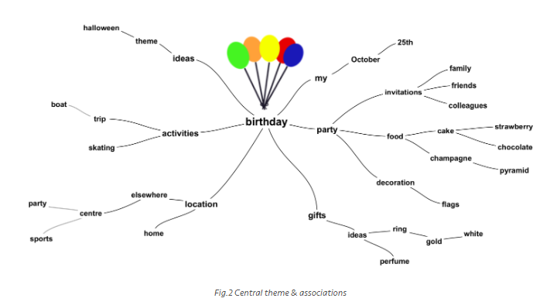
Mind-maps
2. Associations
From the central theme associations radiate out.
Associations directly from the central theme are called first level associations. Then second level associations are created, third level and so on.
The brain thinks by imagination and association. When associations are created, connections are made.
These connections are essential for remembering and thinking.

Slide 31
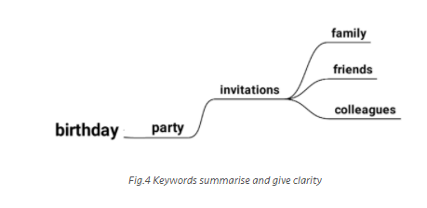
Mind-maps
3. Key-words
Mind maps summarize information. Instead of sentences, ideally only single keywords are used.
A single word per association gives more freedom, creativity and clarity.

Slide 32
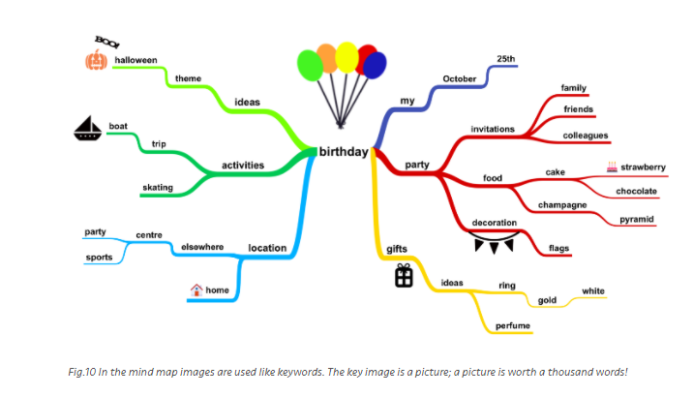
Mind-maps
4. Colour & images
The use of colour is important in the mind map.
Research shows that people who use colour and images in their imagination, when they are learning, are better in remembering than those who don’t.
Mind maps summarize information. Instead of sentences, ideally only single keywords are used.
A single word per association gives more clarity.
Notes:
https://simplemind.eu/how-to-mind-map/basics/

Slide 33
Mind-mapping
Task:
Let’s have a go at using the mind-mapping method now
Take a blank page in your booklet (page 9)
Create a mind-map that will help you to plan and order ideas for your poster
PAUSE HERE

Slide 34
Reflections
How did you find each note taking method?
Which of these methods will you keep using?
What didn’t work for you?

Slide 35
6.Creating your own scientific research poster

Slide 36
6.Is there any numerical data in your research article?
How could you incorporate this data it into your poster?
Article: Rapid Covid testing in England may be scaled back over false positives
Data: “Data obtained by the BBC from 26m lateral flow tests in March found that, among 30,904 positive results, 82% were correct and 18% were false positives.”
www.causeway.education
Notes:
Is there any data in the article? How would you incorporate it in the poster.
Make sure they include some numerical data (demo some pie-charts/bar charts).

Slide 37
6.Is there any numerical data in your research article?

Slide 38
6.Is there any numerical data in your research article?

Slide 39
6.Creating your own scientific research poster
Task:
Now it’s time for you to create your own scientific research poster.
Create your poster using the research article and YouTube video you have been looking at.
Remember:
Use the checklist of what makes a good scientific poster (booklet, page 10)
Include key vocabulary using the glossary you created
Represent numerical data in appropriate tables/graphs
Use diagrams and images where appropriate instead of text.

Slide 40

Thank you

