Slide 1
Wadham Project Workshop: Prisoner’s Dilemma
Dr Hugh Munro
Wadham College, University of Oxford

Slide 2
Prisoner’s Dilemma
Notes:
https://unsplash.com/@brain1966

Slide 3
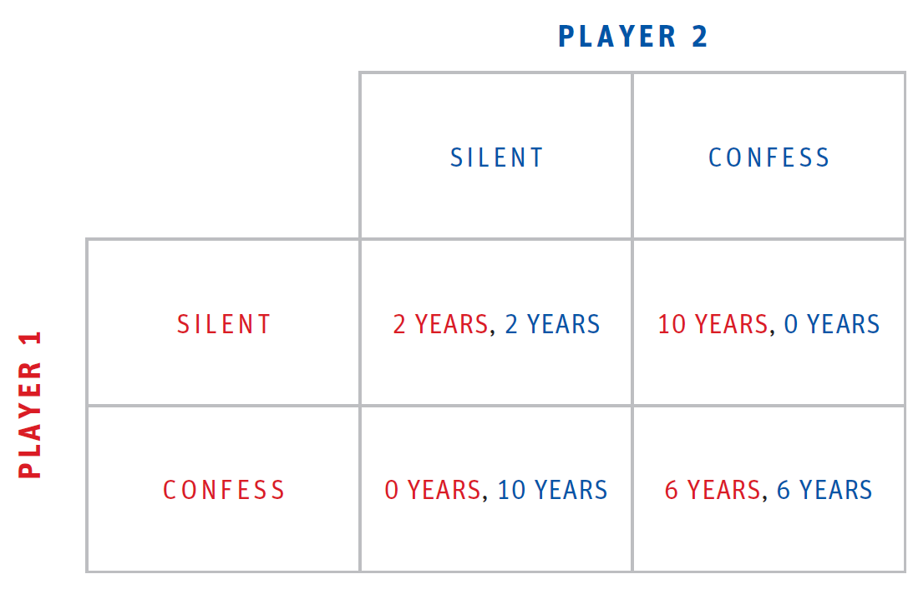
Prisoner’s Dilemma

Slide 4
Prisoner’s Dilemma Questions
How did you make your decision about whether to confess or stay silent?
Suppose you had been able to talk to your partner. How would that have changed the game, or the way you made your decision?
How could reciprocity- “I scratch your back, you scratch mine”- come into play in this game?

Slide 5
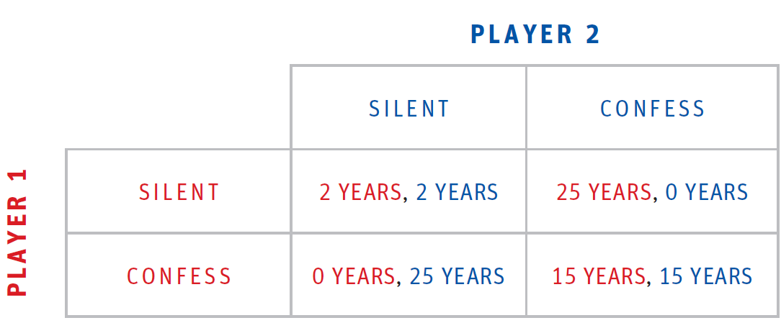
Prisoner’s Dilemma:
Varying consequences 1

Slide 6
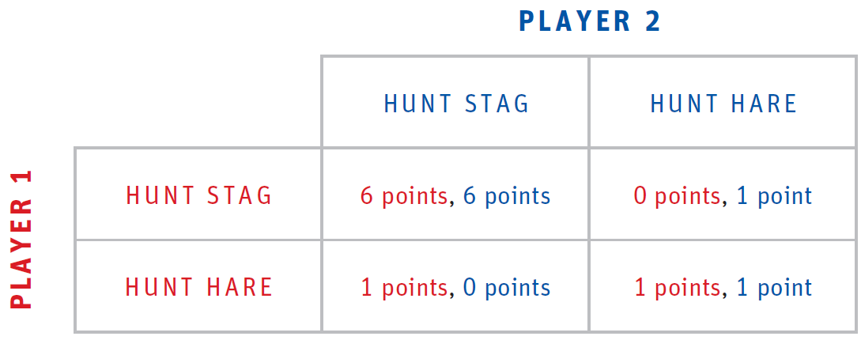
Prisoner’s Dilemma:
Varying consequences 2

Slide 7
Prisoner’s Dilemma

Slide 8
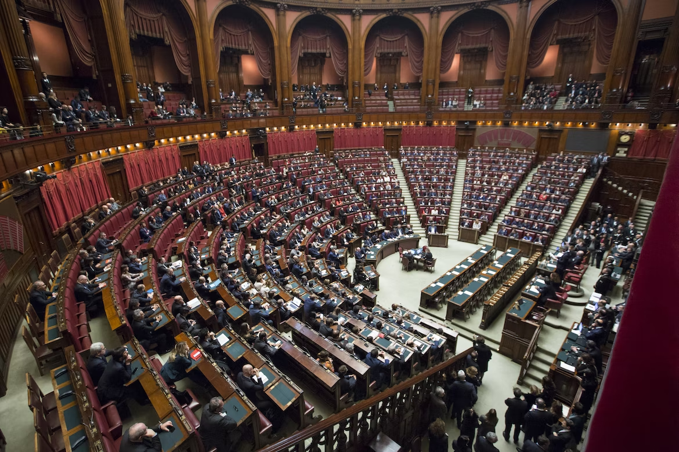
Practical Applications:
Politics & International Relations
Notes:
https://unsplash.com/@drewbutler
https://unsplash.com/@marcooriolesi

Slide 9
Practical Applications:
Economics
In a market where two companies dominate, a prisoner’s dilemma can emerge as they try to maximise profits:
If both keep prices high, profits increase
If one lowers price (confesses) and other doesn’t the company lowering price gains
If both lower prices, profits increase (people buy more)
It would be in their best interests to co-operate to fix a price to maximise both of their profits
Notes:
https://unsplash.com/@jamesyarema
https://unsplash.com/@philipmyr

Slide 10
Practical Applications:
Economics
This is complicated by laws which prevent companies from price fixing
BA, Lufthansa, Virgin and other major airlines have been investigated by Office of Fair Trading (UK) and Department of Justice (USA)

Slide 11
Practical Applications:
Sport
Performance-enhancing drugs:
If I don’t take it and the other one takes it, this increases my chances of losing
If I take it and the other one doesn’t take it, this increases my chances of winning
If both of us take it, then at least I’m not disadvantaged
https://www.open.edu/openlearn/money-management/management/business-research-methods/airlines-face-the-prisoners-dilemma
Notes:
https://unsplash.com/@markusspiske

Slide 12
Follow up
TED-Ed How to outsmart the Prisoner’s Dilemma
- Lucas Husted
https://www.youtube.com/watch?v=emyi4z-O0ls
Notes:
https://unsplash.com/@brain1966

